Slide 1
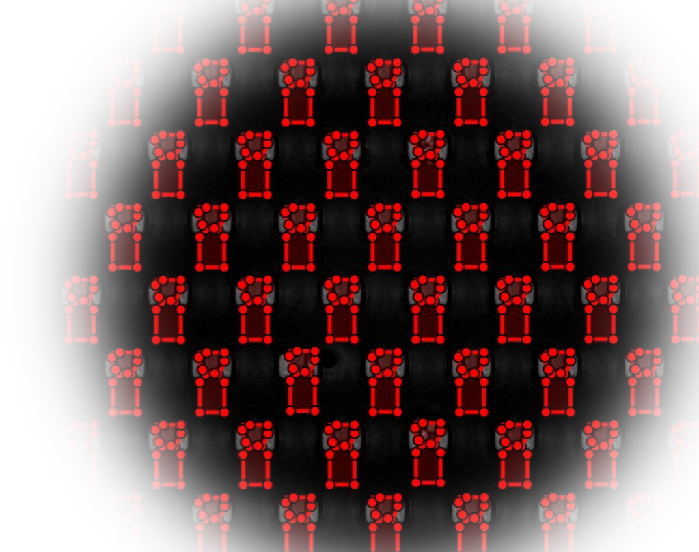
Application for MicroBREW
Authors: Oshil Ghimire, Bishal Paudel

Slide 2

Repository
yyc2wf/MicroBREW_Generalization

Slide 3
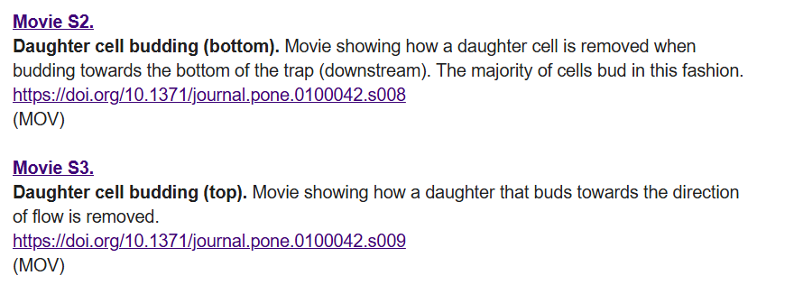
Source
A Microfluidic System for Studying Ageing and Dynamic Single-Cell Responses in Budding Yeast | PLOS One

Slide 4


Summary
Movie s2 (budding on bottom)
We applied a simplified, single-trap version of the MicroBREW pipeline to the two 34-frame movies shown towards the left
To demonstrate how our MicroBREW method generalizes to different imaging conditions / parameters
Movie s3 (budding on top)

Slide 5
Full Data Pipeline (How To Run)
MATLAB – Image process, and output signals
For MovieS2: $ MicroBREWS_combined('s2');
For MovieS3: $MicroBREWS_combined('s3');
R – smooth, normalize, and find peaks
For MovieS2: $ res_s2 <- analyze_movie_signals("s2") res_s2$peaks
For MoviesS3: $ res_s3 <- analyze_movie_signals("s3") res_s3$peaks

Slide 6
Movie S2 & S3(MATLAB)
Loop
Loop 34 different images
Detect
Detect the trap centroid
Normalize and clean
Normalize and clean Image (basic resolution)
Draw
Draw Region Of Interest (ROI)
Capture
Capture signals in each frame
Output
Output a csv: (FrameID, signal)

Slide 7
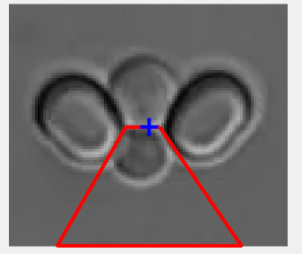
ROI used in Movie S2
%For this ROI
vertices = [c(1)+4, c(2);
c(1)-9, c(2);
c(1)-35, c(2)+45;
c(1)+35, c(2)+45];
%Blue plus is the Centroid, in this example defined as “c”

Slide 8
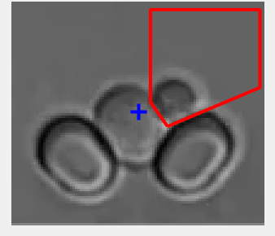
ROI used in Movie S2
%For this ROI
vertices = [c(1)+12, c(2)+6;
c(1)+50, c(2)-10;
c(1)+50, c(2)-42;
c(1)+5, c(2)-42;
c(1)+5, c(2)-4];
%Blue plus is the Centroid, in this example defined as “c”

Slide 9
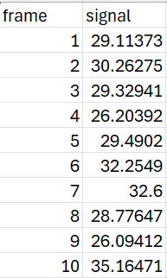
Movie S2 & S3 (CSV example)

Slide 10
Movie S2 & S3 (R – post processing)
Read
Read the CSV file fetched from MATLAB script
Get
Get the average signal using rollmean function
Normalize
Normalize the signal for generalization
Use
Use findpeaks to find how many peaks the graph has

Slide 11
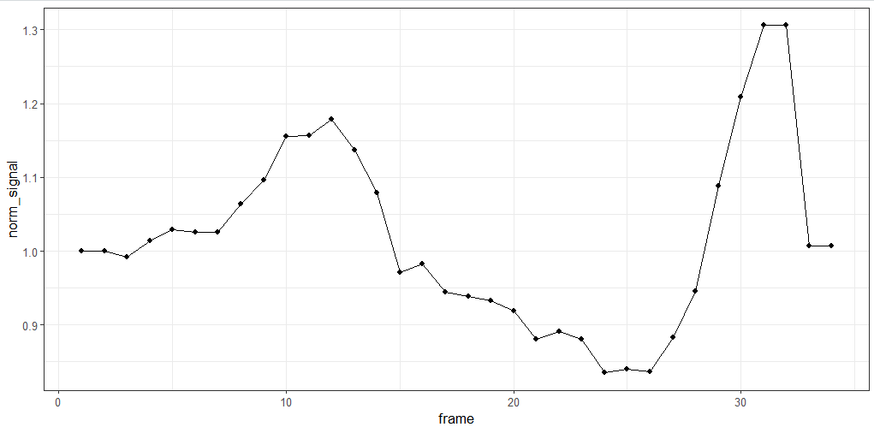

Movie S2(Normalized graph & FindPeaks)
Findpeaks tells us there is 2 budding event in MovieS2
  Frame 12, 31

Slide 12
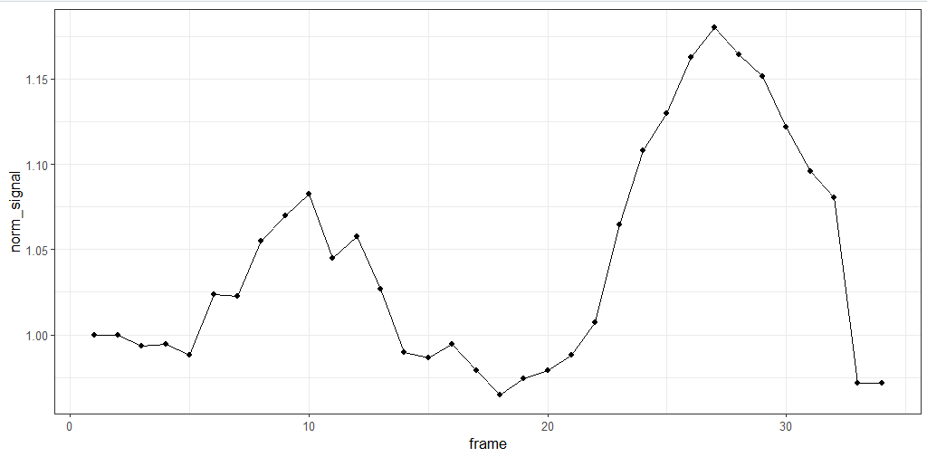
Movie S3(Normalized graph & FindPeaks)
Findpeaks tells us there is 1 budding event in MovieS3
  Frame 21

Slide 13
Why Peaks?
As a cell enters and grows in the trap, the fluorescence/intensity rises.
When the cell buds or separates, the signal drops sharply.
These rise-and-crash patterns appear as peaks, so peaks act as clear markers of cell separation events.

